Slide 1
Backpropagation

Slide 2
Outline
What is Back Propagation?
Back Propagation Example

Slide 3
What is Backpropagation?
Backpropagation is the process of adjusting the parameters of a neural network by analyzing the loss from the previous iteration

Slide 5
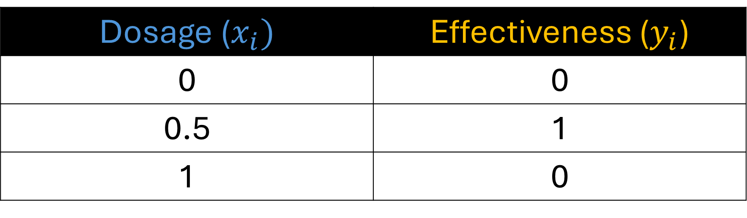
Training Data
Dosage ($x_{i})$ | Effectiveness ($y_{i}$)
0 | 0
0.5 | 1
1 | 0
Imagine that we have a dataset containing the amount of dosage given to a patient and their effectiveness where 0 is not effective and 1 is effective.

Slide 6
Training Data
Dosage ($x_{i})$ | Effectiveness ($y_{i}$)
0 | 0
0.5 | 1
1 | 0
Let us call all inputs $x_{i}$ and our observed outputs $y_{i}$. We will these inputs and run them to our neural network.

Slide 7




This is the neural network that we will train using our small dataset
$$b$$
$${ x}_{i}$$
$$b$$
$$b$$
Input Layer
Hidden Layer
Output Layer

Slide 8
Our neural network contains 1 hidden layer with 2 neurons.
$$b$$
$${ x}_{i}$$
$$b$$
$$b$$
Input Layer
Hidden Layer
Output Layer

Slide 9







$$b_{1}$$
Our neural network has a total of 7 parameters, let us name each of our parameter…
$$b$$
$$w_{1}$$
$$w_{3}$$
$${ x}_{i}$$
$$b_{3}$$
$$b$$
$$w_{2}$$
$$w_{4}$$
$$b$$
$$b_{2}$$
Input Layer
Hidden Layer
Output Layer

Slide 10


$$b_{1}$$
$$Weights: w_{1},w_{2} ,w_{3},w_{4}$$
$$b$$
$$Biases: b_{1},b_{2},b_{3}$$
$$w_{1}$$
$$w_{3}$$
$${ x}_{i}$$
$$b_{3}$$
$$b$$
$$w_{2}$$
$$w_{4}$$
$$b$$
$$b_{2}$$
Input Layer
Hidden Layer
Output Layer

Slide 11
$$b_{1}$$
In practice, the weights and biases are initialized with a random value.
$$b$$
$$w_{1}$$
$$w_{3}$$
$${ x}_{i}$$
$$b_{3}$$
$$b$$
$$w_{2}$$
$$w_{4}$$
$$b$$
$$b_{2}$$
Input Layer
Hidden Layer
Output Layer

Slide 12







$$???$$
In practice, the weights and biases are initialized with a random value.
$$b$$
$$???$$
$$???$$
$${ x}_{i}$$
$$???$$
$$b$$
$$???$$
$$???$$
$$b$$
$$???$$
Input Layer
Hidden Layer
Output Layer

Slide 13
$$???$$
And backpropagation is used to estimate all parameters
$$b$$
$$???$$
$$???$$
$${ x}_{i}$$
$$???$$
$$b$$
$$???$$
$$???$$
$$b$$
$$???$$
Input Layer
Hidden Layer
Output Layer

Slide 14
$$???$$
Conceptually, backpropagation starts with the last parameter
$$b$$
$$???$$
$$???$$
$${ x}_{i}$$
$$???$$
$$b$$
$$???$$
$$???$$
$$b$$
$$???$$
Input Layer
Hidden Layer
Output Layer

Slide 15

$$???$$
And works its way backwards to estimate all of the parameters
$$b$$
$$???$$
$$???$$
$${ x}_{i}$$
$$2.61$$
$$b$$
$$???$$
$$???$$
$$b$$
$$???$$
Input Layer
Hidden Layer
Output Layer

Slide 16


$$???$$
And works its way backwards to estimate all of the parameters
$$b$$
$$???$$
$$−1.22$$
$${ x}_{i}$$
$$2.61$$
$$b$$
$$???$$
$$−2.30$$
$$b$$
$$???$$
Input Layer
Hidden Layer
Output Layer

Slide 17


$$−1.43$$
And works its way backwards to estimate all of the parameters
$$b$$
$$???$$
$$−1.22$$
$${ x}_{i}$$
$$2.61$$
$$b$$
$$???$$
$$−2.30$$
$$b$$
$$0.57$$
Input Layer
Hidden Layer
Output Layer

Slide 18


$$−1.43$$
And works its way backwards to estimate all of the parameters
$$b$$
$$3.34$$
$$−1.22$$
$${ x}_{i}$$
$$2.61$$
$$b$$
$$−3.53$$
$$−2.30$$
$$b$$
$$0.57$$
Input Layer
Hidden Layer
Output Layer

Slide 19
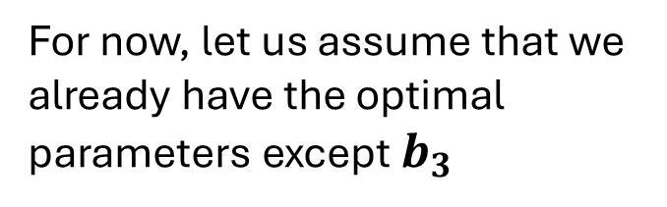
$$−1.43$$
For now, let us assume that we already have the optimal parameters except $b_{3}$
$$b$$
$$3.34$$
$$−1.22$$
$${ x}_{i}$$
$$???$$
$$b$$
$$−3.53$$
$$−2.30$$
$$b$$
$$0.57$$
Input Layer
Hidden Layer
Output Layer

Slide 20


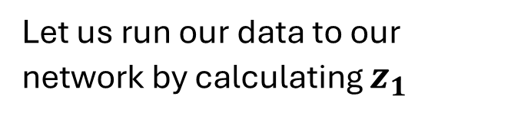
$$−1.43$$
Let us run our data to our network by calculating $z_{1}$
$$b$$
Softplus
$$z_{1}$$
$$3.34$$
$$−1.22$$
$${ x}_{i}$$
$$???$$
$$b$$
$$−3.53$$
$$−2.30$$
$$b$$
$$z_{1}= w_{1} x_{i}+b_{1}$$
$$0.57$$
Input Layer
Hidden Layer
Output Layer

Slide 21
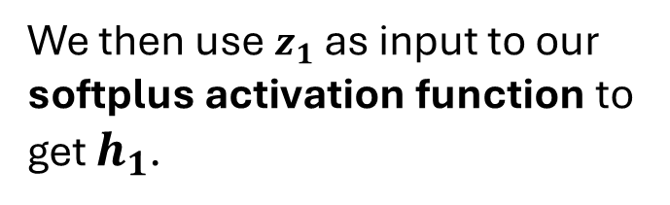



$$−1.43$$
We then use $z_{1}$ as input to our softplus activation function to get $h_{1}$.
$$b$$
Softplus
$$h_{1}$$
$$z_{1}$$
$$3.34$$
$$−1.22$$
$${ x}_{i}$$
$$???$$
$$b$$
$$−3.53$$
$$−2.30$$
$$b$$
$$z_{1}= w_{1} x_{i}+b_{1}$$
$$0.57$$
$$h_{1}=\log{(1+e^{z_{1}})}$$
Input Layer
Hidden Layer
Output Layer

Slide 22


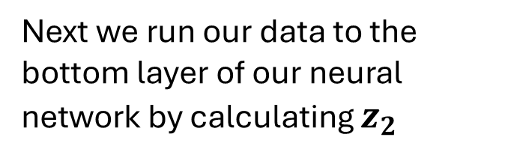
$$−1.43$$
Next we run our data to the bottom layer of our neural network by calculating $z_{2}$
$$b$$
Softplus
$$h_{1}$$
$$z_{1}$$
$$3.34$$
$$−1.22$$
$${ x}_{i}$$
$$???$$
$$b$$
$$−3.53$$
$$−2.30$$
$$b$$
Softplus
$$z_{2}= w_{2} x_{i}+b_{2}$$
$$z_{2}$$
$$0.57$$
Input Layer
Hidden Layer
Output Layer

Slide 23
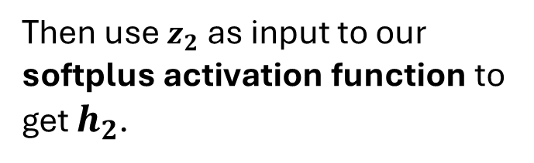




$$−1.43$$
Then use $z_{2}$ as input to our softplus activation function to get $h_{2}$.
$$b$$
Softplus
$$h_{1}$$
$$z_{1}$$
$$3.34$$
$$−1.22$$
$${ x}_{i}$$
$$???$$
$$b$$
$$−3.53$$
$$−2.30$$
$$b$$
Softplus
$$h_{2}$$
$$z_{2}= w_{2} x_{i}+b_{2}$$
$$z_{2}$$
$$0.57$$
$$h_{2}=\log{(1+e^{z_{2}})}$$
Input Layer
Hidden Layer
Output Layer

Slide 24
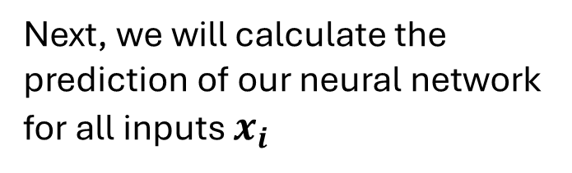


$$−1.43$$
Next, we will calculate the prediction of our neural network for all inputs $x_{i}$
$$b$$
Softplus
$$h_{1}$$
$$z_{1}$$
$$3.34$$
$$−1.22$$
$${ x}_{i}$$
$$???$$
$$b$$
$$\hat{p_{i}}$$
$$−3.53$$
$$−2.30$$
$$b$$
Softplus
$$h_{2}$$
$$z_{2}$$
$$\hat{p_{i}}= h_{1} w_{3}+h_{2} w_{4}+b_{3}$$
$$0.57$$
Input Layer
Hidden Layer
Output Layer

Slide 25

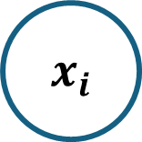



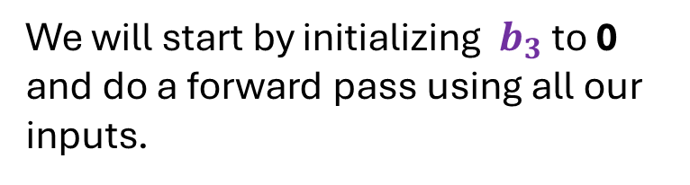






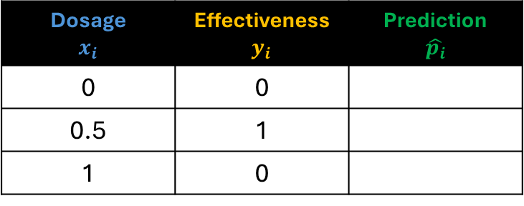





Dosage $$x_{i}$$ | Effectiveness $y_{i}$ | Prediction $$\hat{p_{i}}$$
0 | 0
0.5 | 1
1 | 0
$$−1.43$$
$$b$$
Softplus
$$h_{1}$$
$$z_{1}$$
$$3.34$$
$$−1.22$$
$${ x}_{i}$$
$$0$$
$$b$$
$$\hat{p_{i}}$$
$$−3.53$$
$$−2.30$$
We will start by initializing $b_{3}$ to 0 and do a forward pass using all our inputs.
$$b$$
Softplus
$$h_{2}$$
$$z_{2}$$
$$0.57$$

Slide 26



Dosage $$x_{i}$$ | Effectiveness $y_{i}$ | Prediction $$\hat{p_{i}}$$
0 | 0 | -2.6
0.5 | 1
1 | 0
$$−1.43$$
$$b$$
Softplus
$$h_{1}$$
$$z_{1}$$
$$3.34$$
$$−1.22$$
$$0$$
$$0$$
$$b$$
$$−2.6$$
$$−3.53$$
$$−2.30$$
For our first forward pass, we get -2.6
$$b$$
Softplus
$$h_{2}$$
$$z_{2}$$
$$0.57$$

Slide 27
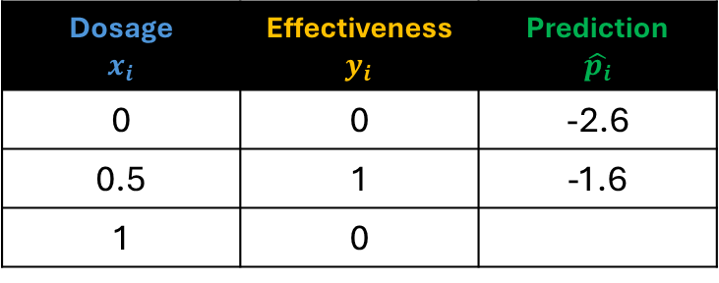


Dosage $$x_{i}$$ | Effectiveness $y_{i}$ | Prediction $$\hat{p_{i}}$$
0 | 0 | -2.6
0.5 | 1 | -1.6
1 | 0
$$−1.43$$
$$b$$
Softplus
$$h_{1}$$
$$z_{1}$$
$$3.34$$
$$−1.22$$
$$0.5$$
$$0$$
$$b$$
$$−1.6$$
$$−3.53$$
$$−2.30$$
For our second forward pass, we get -1.6
$$b$$
Softplus
$$h_{2}$$
$$z_{2}$$
$$0.57$$

Slide 28



Dosage $$x_{i}$$ | Effectiveness $y_{i}$ | Prediction $$\hat{p_{i}}$$
0 | 0 | -2.6
0.5 | 1 | -1.6
1 | 0 | -2.61
$$−1.43$$
$$b$$
Softplus
$$h_{1}$$
$$z_{1}$$
$$3.34$$
$$−1.22$$
$$1$$
$$0$$
$$b$$
$$−2.61$$
$$−3.53$$
$$−2.30$$
And for the third forward pass, we get -2.61
$$b$$
Softplus
$$h_{2}$$
$$z_{2}$$
$$0.57$$

Slide 29
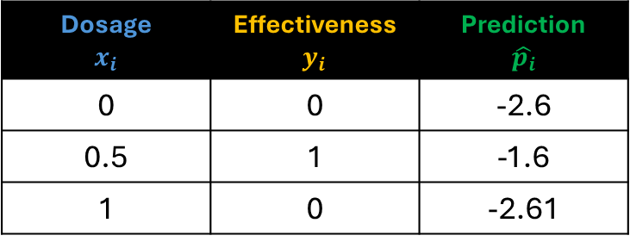
Dosage $$x_{i}$$ | Effectiveness $y_{i}$ | Prediction $$\hat{p_{i}}$$
0 | 0 | -2.6
0.5 | 1 | -1.6
1 | 0 | -2.61
$$−1.43$$
$$b$$
Softplus
$$h_{1}$$
$$z_{1}$$
$$3.34$$
$$−1.22$$
$${ x}_{i}$$
$$0$$
Loss function
$$b$$
$$\hat{p_{i}}$$
$$−3.53$$
$$−2.30$$
Next, we will compute the total loss. In our example we will use the Sum of Squared Error loss function.
$$b$$
Softplus
$$h_{2}$$
$$z_{2}$$
$$0.57$$

Slide 30
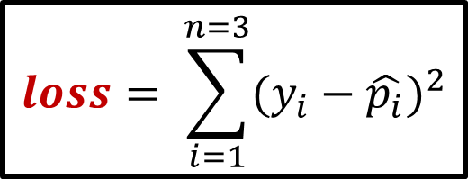
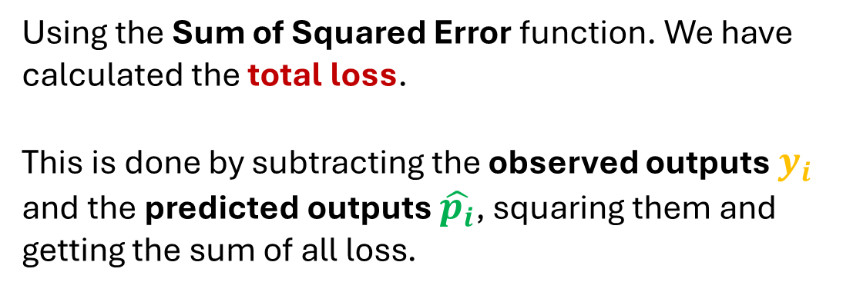

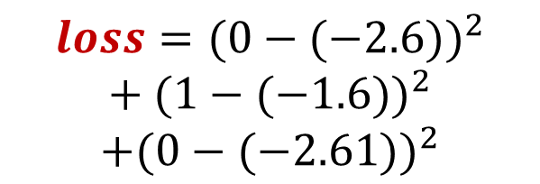
Using the Sum of Squared Error function. We have calculated the total loss.
This is done by subtracting the observed outputs $y_{i}$ and the predicted outputs $\hat{p_{i}}$, squaring them and getting the sum of all loss.
Dosage $$x_{i}$$ | Effectiveness $y_{i}$ | Prediction $$\hat{p_{i}}$$
0 | 0 | -2.6
0.5 | 1 | -1.6
1 | 0 | -2.61
$$loss= \sum_{i=1}^{n=3}{{(y_{i}−\hat{p_{i}})}^{2}}$$
$$loss={(0−(−2.6))}^{2}$$
$$\text{+ }{(1−(−1.6))}^{2}$$
$$+{(0−(−2.61))}^{2}$$
$$loss=20.331$$

Slide 31
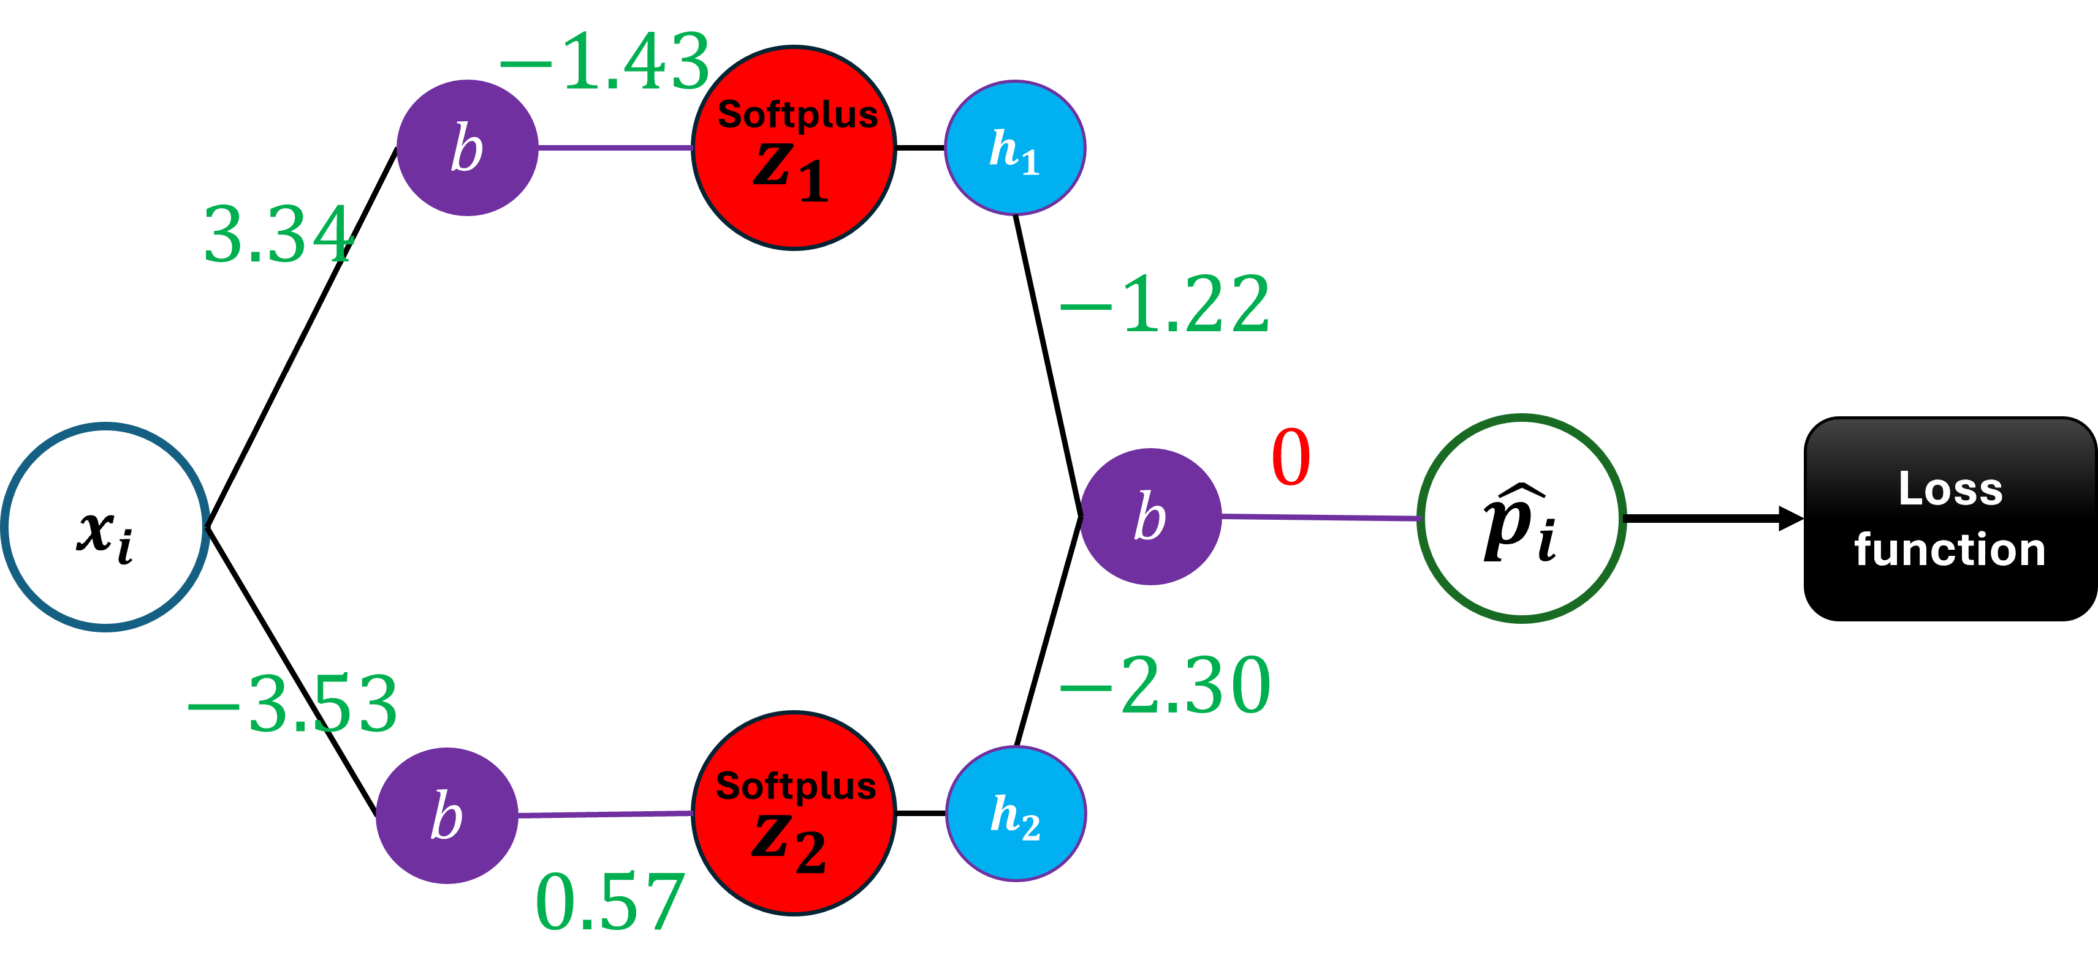
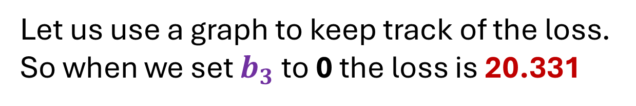

Loss
20.331
$$b_{3}$$
Let us use a graph to keep track of the loss.
So when we set $b_{3}$ to 0 the loss is 20.331

Slide 32
Loss
20.331
$$b_{3}$$
And that corresponds to this location in this graph that has the loss on the y-axis and the bias on the x-axis

Slide 33
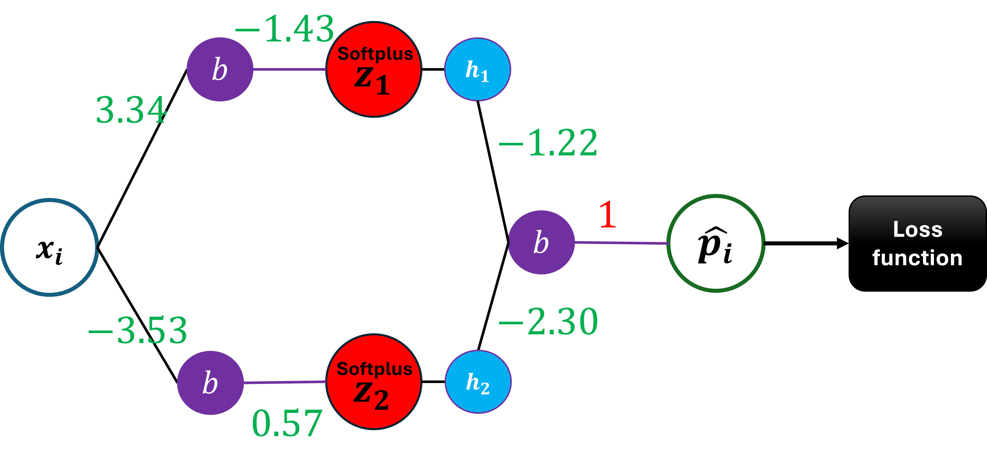
Loss
7.8
$$b_{3}$$
If we increase $b_{3}$ to 1 we get, a loss of 7.8

Slide 34

Loss
1.11
$$b_{3}$$
If we increase $b_{3}$ to 2 we get, a loss of 1.11

Slide 35

Loss
0.46
$$b_{3}$$
If we increase $b_{3}$ to 3 we get, a loss of 0.46

Slide 36
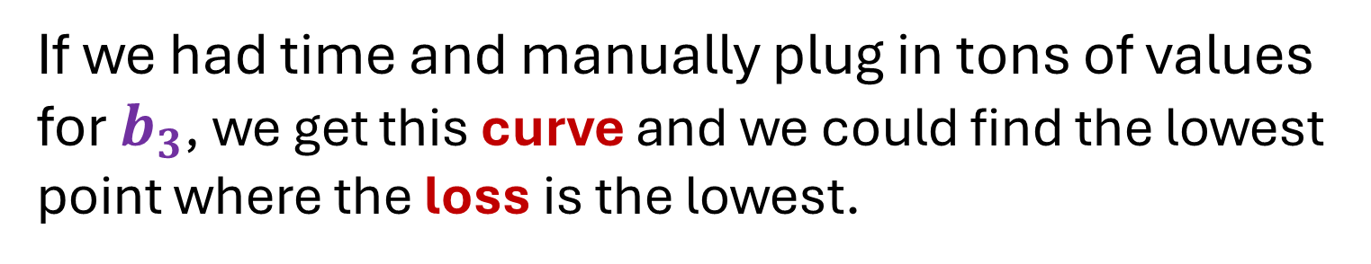
Loss
0.46
$$b_{3}$$
If we had time and manually plug in tons of values for $b_{3}$, we get this curve and we could find the lowest point where the loss is the lowest.

Slide 37
Loss
0.46
$$b_{3}$$
Instead of doing that, we will use Gradient Descent to find it relatively quickly.

Slide 38
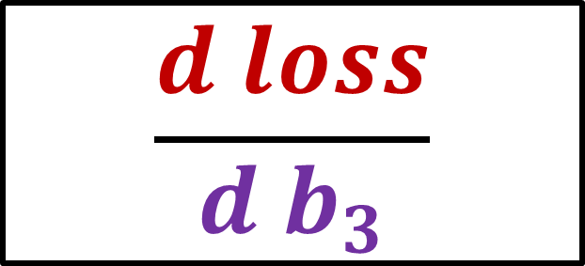

$$\frac{d loss}{{d b}_{3}}$$
Loss
$$b_{3}$$
And that means we will need to find the derivative of the Loss with respect to $b_{3}$

Slide 39
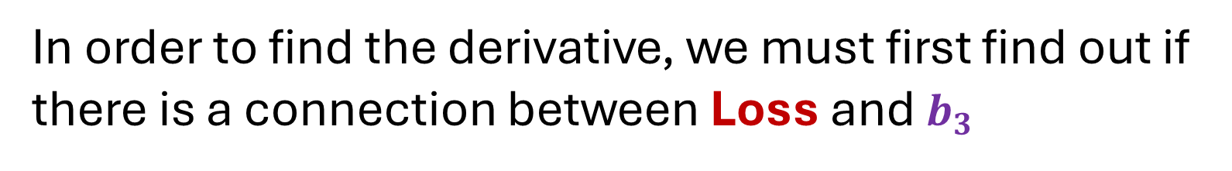
$$\frac{d loss}{{d b}_{3}}$$
Loss
$$b_{3}$$
In order to find the derivative, we must first find out if there is a connection between Loss and $b_{3}$

Slide 40
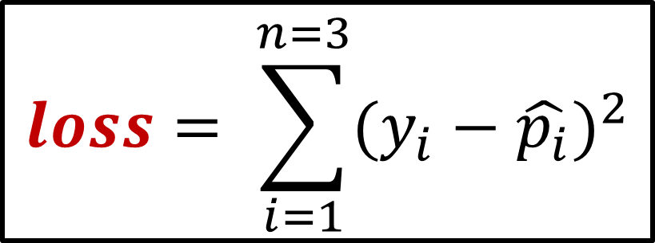
$$loss= \sum_{i=1}^{n=3}{{(y_{i}−\hat{p_{i}})}^{2}}$$
Loss
$$b_{3}$$
Remember the loss function we used to calculate the total loss?

Slide 41
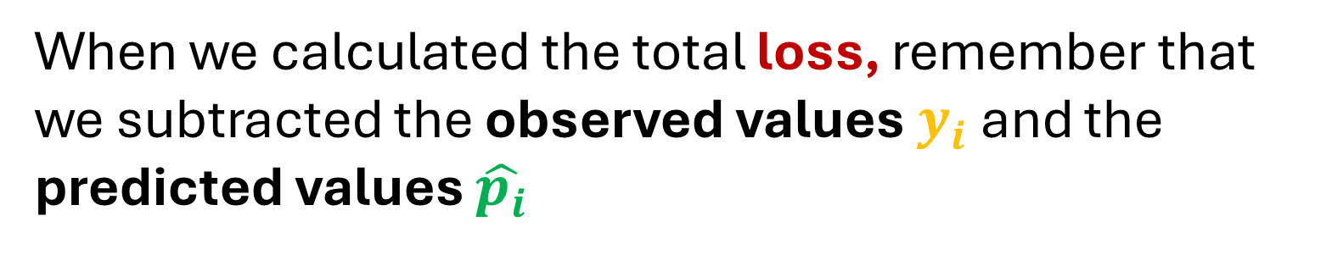
$$loss= \sum_{i=1}^{n=3}{{(y_{i}−\hat{p_{i}})}^{2}}$$
Loss
$$b_{3}$$
When we calculated the total loss, remember that we subtracted the observed values $y_{i}$ and the predicted values $\hat{p_{i}}$

Slide 42

$$loss= \sum_{i=1}^{n=3}{{(y_{i}−\hat{p_{i}})}^{2}}$$
Loss
$$b_{3}$$
Now let us talk about a little bit more about the predicted values $\hat{p_{i}}$

Slide 43

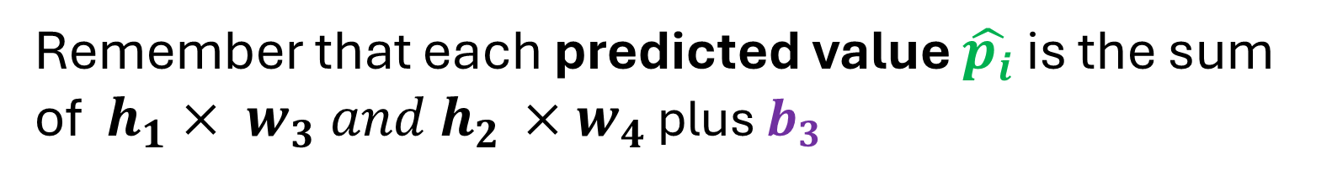
$$loss= \sum_{i=1}^{n=3}{{(y_{i}−\hat{p_{i}})}^{2}}$$
Loss
$$\hat{p_{i}}= h_{1} w_{3}+h_{2} w_{4}+b_{3}$$
$$b_{3}$$
Remember that each predicted value $\hat{p_{i}}$ is the sum of ${ h}_{1} × w_{3} and h_{2 }×w_{4}$ plus $b_{3}$

Slide 44



$$loss= \sum_{i=1}^{n=3}{{(y_{i}−\hat{p_{i}})}^{2}}$$
Loss
$$\hat{p_{i}}= h_{1} w_{3}+h_{2} w_{4}+b_{3}$$
$$b_{3}$$
We can see that Loss and $b_{3}$ are linked or connected by the predicted values $\hat{p_{i}}$

Slide 45


$$loss= \sum_{i=1}^{n=3}{{(y_{i}−\hat{p_{i}})}^{2}}$$
$$\hat{p_{i}}= h_{1} w_{3}+h_{2} w_{4}+b_{3}$$
And because Loss and $b_{3}$ are linked or connected by the predicted values $\hat{p_{i}}$…

Slide 46
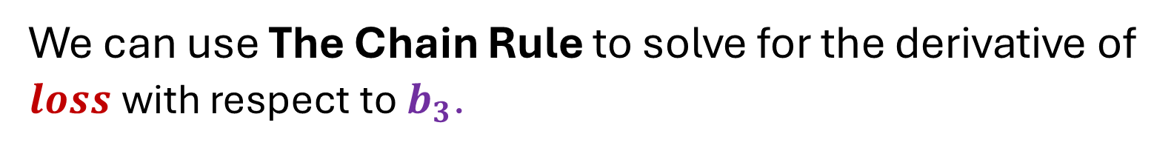

$$\frac{d loss}{{d b}_{3}}$$
We can use The Chain Rule to solve for the derivative of $loss$ with respect to $b_{3}$.

Slide 47

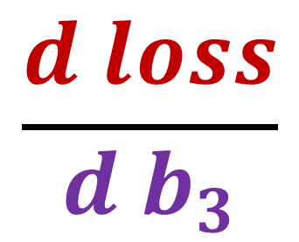
$$\frac{d loss}{{d b}_{3}}$$
The Chain Rule says that the derivative of the $loss$ with respect to $b_{3}$

Slide 48
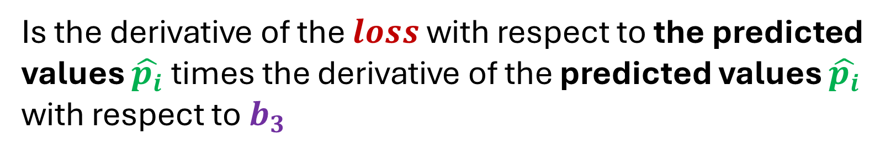
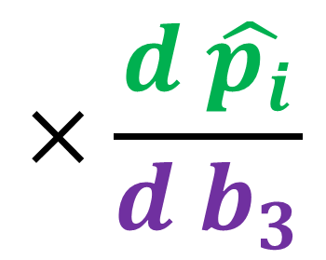
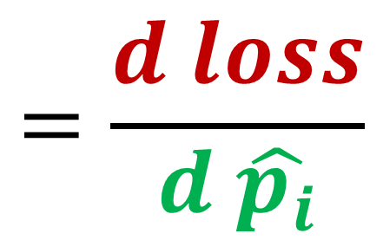
$$\frac{d loss}{{d b}_{3}}$$
$$=\frac{d loss}{d \hat{p_{i}}}$$
$$×\frac{d \hat{p_{i}}}{{d b}_{3}}$$
Is the derivative of the $loss$ with respect to the predicted values $\hat{p_{i}}$times the derivative of the predicted values $\hat{p_{i}}$ with respect to $b_{3}$

Slide 49




$$\frac{d loss}{{d b}_{3}}$$
$$=\frac{d loss}{d \hat{p_{i}}}$$
$$×\frac{d \hat{p_{i}}}{{d b}_{3}}$$
Let us do this step by step and solve for the derivative of $loss$ with respect to the predicted values $\hat{p_{i}}$

Slide 50
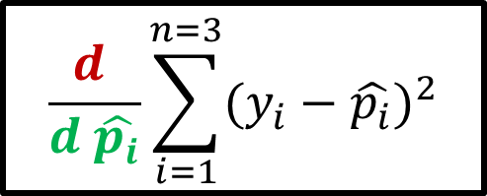
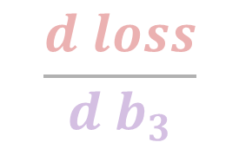
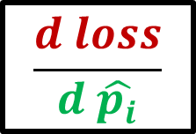

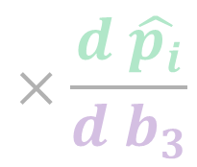
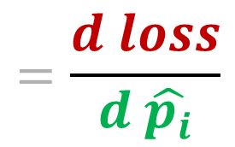
$$\frac{d loss}{{d b}_{3}}$$
$$=\frac{d loss}{d \hat{p_{i}}}$$
$$×\frac{d \hat{p_{i}}}{{d b}_{3}}$$
$$loss= \sum_{i=1}^{n=3}{{(y_{i}−\hat{p_{i}})}^{2}}$$
1. Using the loss function,
$$\frac{d }{d \hat{p_{i}}}\sum_{i=1}^{n=3}{{(y_{i}−\hat{p_{i}})}^{2}}$$
substitute the equation
$$\frac{d loss}{d \hat{p_{i}}}$$
to

Slide 51
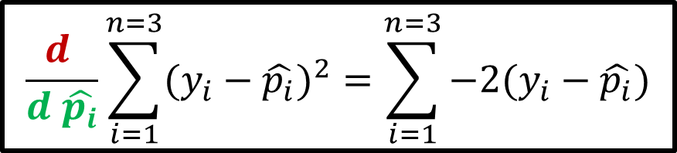
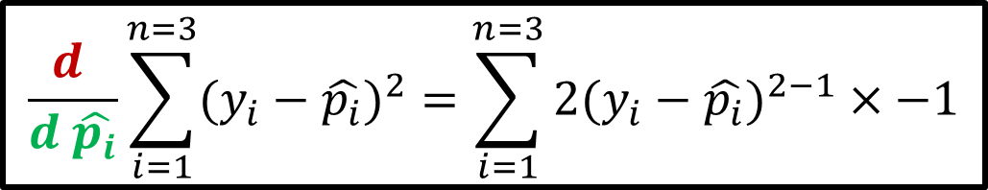

$$\frac{d loss}{{d b}_{3}}$$
$$=\frac{d loss}{d \hat{p_{i}}}$$
$$×\frac{d \hat{p_{i}}}{{d b}_{3}}$$
$$\frac{d }{d \hat{p_{i}}}\sum_{i=1}^{n=3}{{(y_{i}−\hat{p_{i}})}^{2}}$$
2. Get the derivative of
If we use the power rule, we get…
$$\frac{d }{d \hat{p_{i}}}\sum_{i=1}^{n=3}{{(y_{i}−\hat{p_{i}})}^{2}}=\sum_{i=1}^{n=3}{{2(y_{i}−\hat{p_{i}})}^{2−1}}×−1$$
$$\frac{d }{d \hat{p_{i}}}\sum_{i=1}^{n=3}{{(y_{i}−\hat{p_{i}})}^{2}}=\sum_{i=1}^{n=3}{−2(y_{i}−\hat{p_{i}})}$$

Slide 52
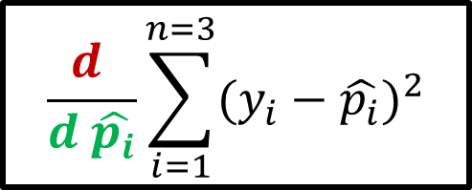
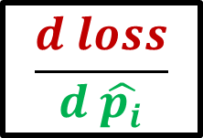
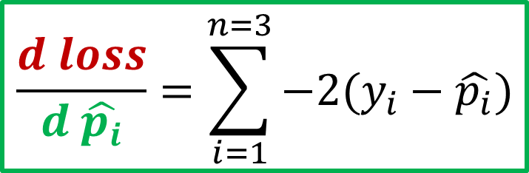
$$\frac{d loss}{{d b}_{3}}$$
$$=\frac{d loss}{d \hat{p_{i}}}$$
$$×\frac{d \hat{p_{i}}}{{d b}_{3}}$$
$$\frac{d }{d \hat{p_{i}}}\sum_{i=1}^{n=3}{{(y_{i}−\hat{p_{i}})}^{2}}$$
3. Substitute back the equation
$$\frac{d loss}{d \hat{p_{i}}}$$
to
$$\frac{d loss}{d \hat{p_{i}}}=\sum_{i=1}^{n=3}{−2(y_{i}−\hat{p_{i}})}$$
We now have the derivative

Slide 53
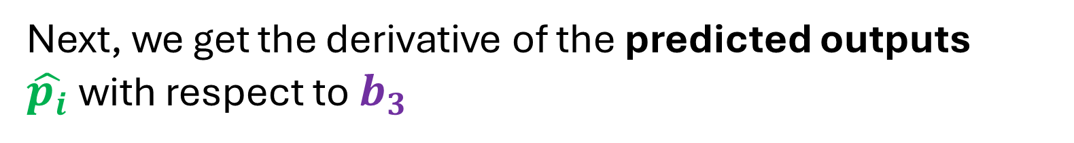
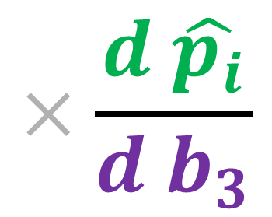

$$\frac{d loss}{{d b}_{3}}$$
$$=\frac{d loss}{d \hat{p_{i}}}$$
$$×\frac{d \hat{p_{i}}}{{d b}_{3}}$$
Next, we get the derivative of the predicted outputs $\hat{p_{i}}$with respect to $b_{3}$

Slide 54
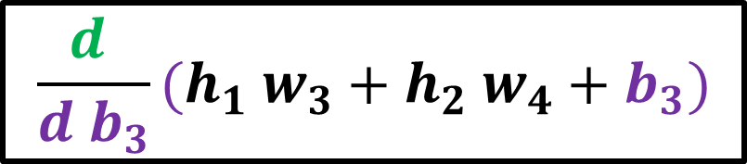
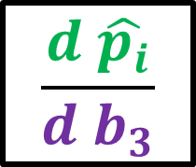

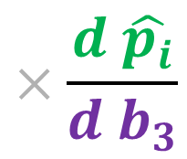
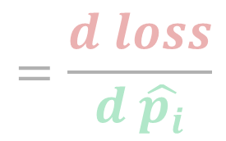
$$\frac{d loss}{{d b}_{3}}$$
$$=\frac{d loss}{d \hat{p_{i}}}$$
$$×\frac{d \hat{p_{i}}}{{d b}_{3}}$$
1. Using the formula to get the predicted values,
$$\hat{p_{i}}= h_{1} w_{3}+h_{2} w_{4}+b_{3}$$
$$\frac{d \hat{p_{i}}}{{d b}_{3}}$$
$$\frac{d }{{d b}_{3}}(h_{1} w_{3}+h_{2} w_{4}+b_{3})$$
substitute the equation
to

Slide 55
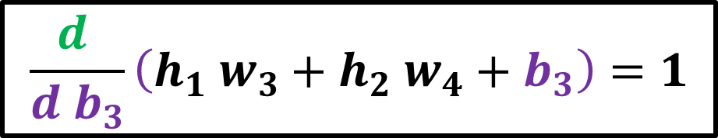
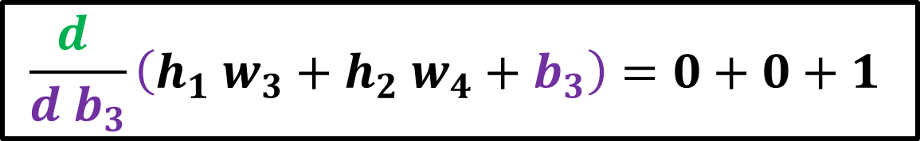
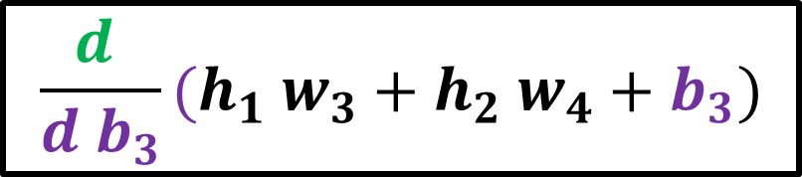
$$\frac{d loss}{{d b}_{3}}$$
$$=\frac{d loss}{d \hat{p_{i}}}$$
$$×\frac{d \hat{p_{i}}}{{d b}_{3}}$$
$$\frac{d }{{d b}_{3}}(h_{1} w_{3}+h_{2} w_{4}+b_{3})$$
2. Get the derivative of
Using the constant rule, we get..
$$\frac{d }{{d b}_{3}}\left(h_{1} w_{3}+h_{2} w_{4}+b_{3}\right)=0+0+1$$
$$\frac{d }{{d b}_{3}}\left(h_{1} w_{3}+h_{2} w_{4}+b_{3}\right)=1$$

Slide 56



$$\frac{d loss}{{d b}_{3}}$$
$$=\frac{d loss}{d \hat{p_{i}}}$$
$$×\frac{d \hat{p_{i}}}{{d b}_{3}}$$
$$\frac{d }{{d b}_{3}}(h_{1} w_{3}+h_{2} w_{4}+b_{3})$$
3. Substitute back the equation
$$\frac{d \hat{p_{i}}}{{d b}_{3}}$$
to
$$\frac{d \hat{p_{i}}}{{d b}_{3}}=1$$
We now have the derivative

Slide 57






$$\frac{d loss}{{d b}_{3}}$$
$$=\frac{d loss}{d \hat{p_{i}}}$$
$$×\frac{d \hat{p_{i}}}{{d b}_{3}}$$
$$\frac{d loss}{d \hat{p_{i}}}=\sum_{i=1}^{n=3}{−2(y_{i}−\hat{p_{i}})}$$
$$\frac{d \hat{p_{i}}}{{d b}_{3}}=1$$
$$\frac{d loss}{{d b}_{3}}=\sum_{i=1}^{n=3}{−2\left(y_{i}−\hat{p_{i}}\right)}×1$$
Now we have both derivatives, we can plug them in

Slide 58


$$\frac{d loss}{{d b}_{3}}$$
$$=\frac{d loss}{d \hat{p_{i}}}$$
$$×\frac{d \hat{p_{i}}}{{d b}_{3}}$$
$$\frac{d loss}{{d b}_{3}}=\sum_{i=1}^{n=3}{−2\left(y_{i}−\hat{p_{i}}\right)}×1$$
Finally, we now have the derivative of the $loss$ with respect to $b_{3}$

Slide 59


$$\frac{d loss}{{d b}_{3}}=\sum_{i=1}^{n=3}{−2\left(y_{i}−\hat{p_{i}}\right)}×1$$
Loss
$$b_{3}$$
And we can use this derivative into Gradient Descent to find the optimal value for $b_{3}$

Slide 60


$$\frac{d loss}{{d b}_{3}}=\sum_{i=1}^{n=3}{−2\left(y_{i}−\hat{p_{i}}\right)}×1$$
Dosage $$x_{i}$$ | Effectiveness $y_{i}$ | Prediction $$\hat{p_{i}}$$
0 | 0 | -2.6
0.5 | 1 | -1.6
1 | 0 | -2.61
Let us plug in the observed values and predicted values in our equation
$$\frac{d loss}{{d b}_{3}} =−2\left(0−\left(−2.6\right)\right)× 1+−2\left(1−\left(−1.6\right)\right)×1+−2\left(0−\left(−2.61\right)\right)× 1$$
And we get…
$$\frac{d loss}{{d b}_{3}} =−15.7$$

Slide 61




$$\frac{d loss}{{d b}_{3}} =−15.7$$
Loss
$$b_{3}$$
-15.7 corresponds to the slope when $b_{3}$ is 0

Slide 62





$$Step Size=Slope ×learningrate$$
Dosage $$x_{i}$$ | Effectiveness $y_{i}$ | Prediction $$\hat{p_{i}}$$
0 | 0 | -2.6
0.5 | 1 | -1.6
1 | 0 | -2.61
Next, we calculate the step size by plugging in the slope -15.7
$$Step Size=−15.7 ×0.1=−1.57$$
We now calculate the new value of $b_{3}$
$$New{ b}_{3}=Old{ b}_{3}−Step Size$$
We get
$$New{ b}_{3}=0−\left(−1.57\right)=1.57$$

Slide 63




Dosage $$x_{i}$$ | Effectiveness $y_{i}$ | Prediction $$\hat{p_{i}}$$
0 | 0
0.5 | 1
1 | 0
$$−1.43$$
$$b$$
Softplus
$$h_{1}$$
$$z_{1}$$
$$3.34$$
$$−1.22$$
$$x_{i}$$
$$1.57$$
$$b$$
$$\hat{p_{i}}$$
$$−3.53$$
$$−2.30$$
We not put 1.57 as our new value for $b_{3}$.
$$b$$
Softplus
$$h_{2}$$
$$z_{2}$$
$$0.57$$

Slide 64

Dosage $$x_{i}$$ | Effectiveness $y_{i}$ | Prediction $$\hat{p_{i}}$$
0 | 0
0.5 | 1
1 | 0
$$−1.43$$
$$b$$
Softplus
$$h_{1}$$
$$z_{1}$$
$$3.34$$
$$−1.22$$
$$x_{i}$$
$$1.57$$
$$b$$
$$\hat{p_{i}}$$
$$−3.53$$
$$−2.30$$
Do the forward pass for each input $x_{i}$ to generate the new predicted values $\hat{p_{i}}$
$$b$$
Softplus
$$h_{2}$$
$$z_{2}$$
$$0.57$$

Slide 65

Dosage $$x_{i}$$ | Effectiveness $y_{i}$ | Prediction $$\hat{p_{i}}$$
0 | 0 | -1.03
0.5 | 1 | -0.03
1 | 0 | -1.04
$$−1.43$$
$$b$$
Softplus
$$h_{1}$$
$$z_{1}$$
$$3.34$$
$$−1.22$$
$$x_{i}$$
$$1.57$$
$$b$$
$$\hat{p_{i}}$$
$$−3.53$$
$$−2.30$$
Do the forward pass for each input $x_{i}$ to generate the new predicted values $\hat{p_{i}}$
$$b$$
Softplus
$$h_{2}$$
$$z_{2}$$
$$0.57$$

Slide 66

$$\frac{d loss}{{d b}_{3}}=\sum_{i=1}^{n=3}{−2\left(y_{i}−\hat{p_{i}}\right)}×1$$
Dosage $$x_{i}$$ | Effectiveness $y_{i}$ | Prediction $$\hat{p_{i}}$$
0 | 0 | -1.03
0.5 | 1 | -0.03
1 | 0 | -1.04
If we plug in the observed values and predicted values in our equation
$$\frac{d loss}{{d b}_{3}} =−2\left(0−\left(−1.03\right)\right)× 1+−2\left(1−\left(−0.03\right)\right)×1+−2\left(0−\left(−1.04\right)\right)× 1$$
And we get…
$$\frac{d loss}{{d b}_{3}} =−6.26$$

Slide 67

$$\frac{d loss}{{d b}_{3}} =−6.26$$
Loss
$$b_{3}$$
-6.26 corresponds to the slope when $b_{3}$ is 1.57

Slide 68
$$Step Size=Slope ×learningrate$$
Dosage $$x_{i}$$ | Effectiveness $y_{i}$ | Prediction $$\hat{p_{i}}$$
0 | 0 | -1.03
0.5 | 1 | -0.03
1 | 0 | -1.04
Next, we calculate the step size by plugging in the slope -6.26
$$Step Size=−6.26 ×0.1=−0.626$$
We now calculate the new value of $b_{3}$
$$New{ b}_{3}=Old{ b}_{3}−Step Size$$
We get
$$New{ b}_{3}=1.57−\left(−0.626\right)=2.19$$

Slide 69

Dosage $$x_{i}$$ | Effectiveness $y_{i}$ | Prediction $$\hat{p_{i}}$$
0 | 0
0.5 | 1
1 | 0
$$−1.43$$
$$b$$
Softplus
$$h_{1}$$
$$z_{1}$$
$$3.34$$
$$−1.22$$
$$x_{i}$$
$$2.19$$
$$b$$
$$\hat{p_{i}}$$
$$−3.53$$
$$−2.30$$
Plugin the new value and this process repeats again and again and only stops if the Step Size is very close to 0
$$b$$
Softplus
$$h_{2}$$
$$z_{2}$$
$$0.57$$

